Slide 1


Heart disease

Slide 2
Introduction
Heart disease, also known as cardiovascular disease, encompasses a range of conditions that affect the heart and blood vessels. It is a leading cause of morbidity and mortality worldwide.
The two primary types of heart disease are ischemic heart disease (narrowing of the coronary arteries) and heart failure (inability of the heart to pump blood effectively). Other conditions include arrhythmias, valvular heart diseases, and congenital heart defects.
Significance of Early Detection and Classification:
Early Intervention and Treatment
Preventing Complications
Risk Stratification and Personalized Treatment
Reducing Healthcare Costs
Patient Education and Lifestyle Modifications
Monitoring and Follow-up

Slide 3
Abstract
Implement machine learning algorithm in order to predict the heart disease
Heart disease classification as a crucial research domain with substantial implications for public health.
The overarching goal in this field is to create methods that are both accurate and efficient in categorizing heart diseases.
The importance of accurate classification lies in its potential to facilitate early detection, prompt treatment, and ultimately enhance patient outcomes.

Slide 4
Objective
To develop a predictive model for detecting the presence of heart disease in patients based on a subset of 14 carefully chosen attributes.
The target variable is binary, where 0 indicates the absence of disease and 1 indicates the presence of heart disease.
The goal is to build a robust and accurate predictive model that can assist in early diagnosis and intervention for individuals at risk of heart disease.

Slide 5

Real World Impact

Slide 6
Here are several potential real-world impacts:
Disease Prediction Models: The dataset provides a valuable resource for developing machine learning models to predict the presence or absence of heart disease. Researchers and data scientists can use this data to build predictive models that analyze various attributes and help identify patterns associated with heart disease.
Clinical Decision Support Systems: Insights gained from the dataset could contribute to the development of clinical decision support systems. These systems could assist healthcare professionals in making more informed decisions by integrating patient data and predicting the likelihood of heart disease based on historical information.
Risk Assessment Tools: The dataset may contribute to the creation of risk assessment tools for individuals. By analyzing the subset of attributes that are most relevant, these tools could provide personalized risk scores for patients, helping them and their healthcare providers make lifestyle and treatment decisions.
Early Detection and Prevention: With accurate prediction models, healthcare providers can potentially identify individuals at risk of heart disease at an early stage. Early detection allows for timely intervention and preventive measures, potentially improving patient outcomes and reducing the overall burden on healthcare systems.

Slide 7
Research on Attribute Relevance: The dataset's large number of attributes allows researchers to explore and identify the most critical factors contributing to heart disease. This could lead to a better understanding of the disease's underlying mechanisms and inform future research directions.
Global Comparisons: Since the dataset includes information from different regions (Cleveland, Hungary, Switzerland, and Long Beach), researchers can analyze and compare patterns of heart disease across different populations. This global perspective could contribute to the development of more universally applicable diagnostic and preventive strategies.
Public Health Planning: Insights from the dataset can inform public health initiatives and policies related to heart disease. Governments and healthcare organizations can use the information to tailor preventive measures and allocate resources more effectively based on the prevalence and risk factors identified in different populations.
Educational Purposes: The dataset can be used for educational purposes, helping students and healthcare professionals understand the complexities of heart disease and the application of data-driven approaches in healthcare.

Slide 8
Dataset UCI Heart Disease dataset
Which contained the following data:
1) age
2) sex
3) chest pain type (4 values)
4) resting blood pressure
5) serum cholestoral in mg/dl
6) fasting blood sugar > 120 mg/dl
7) resting electrocardiographic results
(values 0,1,2)
8) maximum heart rate achieved
9) exercise induced angina
oldpeak = ST depression induced by
exercise relative to rest
the slope of the peak exercise ST
segment
number of major vessels (0-3)
colored by flourosopy
thal: 0 = normal; 1 = fixed defect;
2 = reversable defect
14) The "target" field refers to the presence of heart disease in the patient. It is integer valued 0 = no disease and 1 = disease.

Slide 9
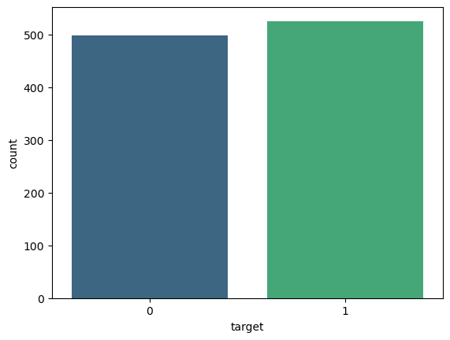
Target Variable

Slide 10
Metric selection and Reasoning
Precision and Recall: Precision measures the proportion of true positive predictions out of all positive predictions, while recall measures the proportion of true positive predictions out of all actual positive cases. These metrics are particularly important if the business wants to balance the need to minimize false positives (approving bad loans) and false negatives (rejecting good loans).
F1 Score: The F1 score is the harmonic mean of precision and recall and provides a balanced measure of a model's performance. It can be useful when there is an uneven distribution between positive and negative cases in the dataset.
ROC Curve and AUC: Receiver Operating Characteristic (ROC) curve and Area Under the Curve (AUC) measure the model's ability to discriminate between good and bad credit risks across different decision thresholds. A high AUC indicates good model performance.

Slide 11
Solution Approach and Problem Type
There are multiple ways in which these are handled to name a few are :
Logical Regression
KNN (K Neighbors Classifier)
Random Forest Classifier
XGboost Classifier
SVC (Support Vector Classifier)
Decision Tree Classifier
Naïve Bayes

Slide 12

Libraries
import numpy as np
import pandas as pd
import matplotlib.pyplot as plt
import seaborn as sns
import missingno as msno
Description of these libraries are as follows:-
Pandas for Dataframe operations
Numpy for Numeric operations
Matplotlib, Seaborn and missingno are Data Visualisation libraries

Slide 13
Visualization

Slide 14
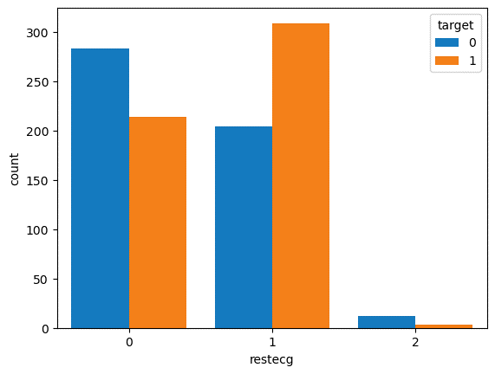
Resting electrocardiographic results (restecg) and (target)

Slide 15
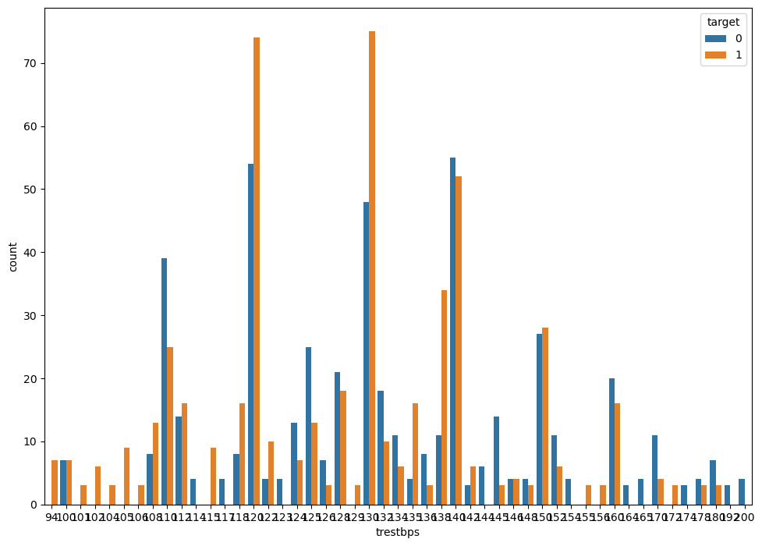
Count of resting blood pressure (trestbps)

Slide 16
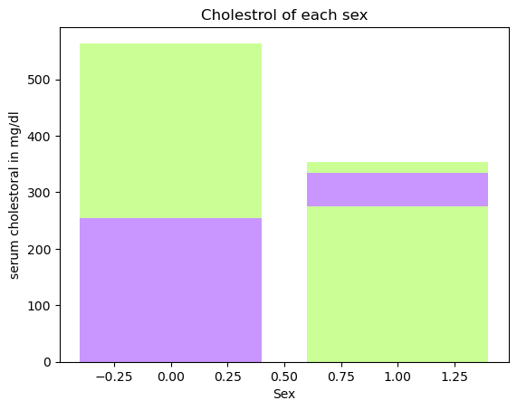

Slide 17
Modeling

Slide 18
Standardize the features
from sklearn.preprocessing import StandardScaler
# Standardize the features (important for KNN)
scaler = StandardScaler()
X_train_scaled = scaler.fit_transform(X_train)
X_test_scaled = scaler.transform(X_test)

Slide 19
Splitting the dataset in to train and test
Module used:
from sklearn.model_selection import train_test_split
Code snippet:
X = df.drop(['target'], axis=1).values
y = df['target'].values
# train-test split
X_train, X_test, y_train, y_test = train_test_split(X, y, test_size = 0.3, random_state=42)

Slide 20
Models used to predict :
1.LogisticRegression
2.KNeighborsClassifier
3.DecisionTreeClassifier
4.RandomForest Classifier
5.Support Vector Classification (SVC)
6.Naive Bayes
7.xgboost

Slide 21
from sklearn.model_selection import GridSearchCV
from sklearn.linear_model import LogisticRegression
from sklearn.neighbors import KNeighborsClassifier
from sklearn.tree import DecisionTreeRegressor
from sklearn.tree import DecisionTreeClassifier
from sklearn.ensemble import RandomForestClassifier
from sklearn.metrics import accuracy_score,f1_score
from sklearn.svm import SVC
from sklearn.naive_bayes import GaussianNB
from sklearn.metrics import accuracy_score, confusion_matrix, classification_report, fbeta_score
import xgboost as xgb
Libraries
for
Modeling

Slide 22
Creating models
models=[0]*7
models[0] = LogisticRegression()
models[1] = KNeighborsClassifier()
models[2] = DecisionTreeClassifier()
models[3] = RandomForestClassifier()
models[4] = SVC()
models[5] = GaussianNB()
models[6] = xgb.XGBClassifier()

Slide 23
def check():
for m in models:
model_name = m.__class__.__name__
model=m
model.fit(X_train,y_train)
y_pred = model.predict(X_test)
print('Model Name: ',model_name)
print("Accuracy score is: ",accuracy_score(y_test,y_pred)*100)
print(confusion_matrix(y_test, y_pred))
print(classification_report(y_test, y_pred))
print()
check()

Slide 24
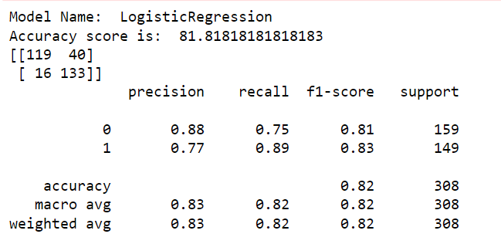
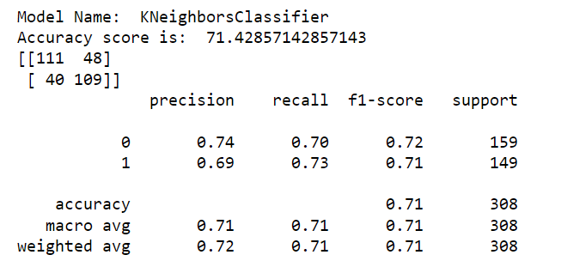

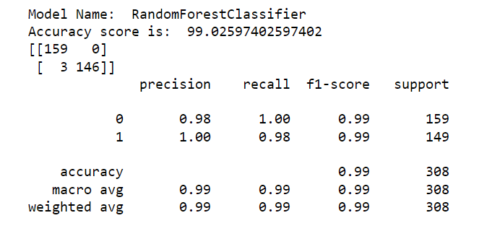
Precision, recall, support,f1-score and accuracy of each model

Slide 25
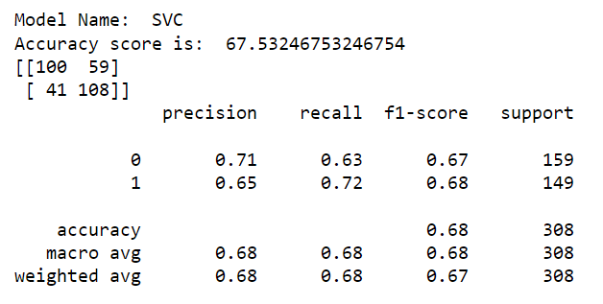
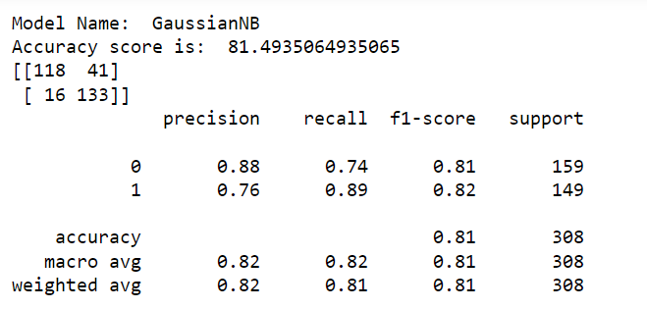
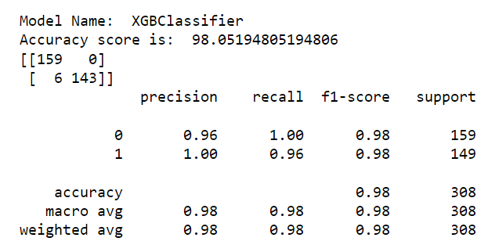
Precision, recall, support,f1-score and accuracy of each model

Slide 26
So we get the highest accuracy score that is 99 and 98.05 in Random Forest and XG Boost respectively

Slide 27
Hyperparameter tuning
Define hyperparameter grids for each model
param_grids = [
{'C': [0.001, 0.01, 0.1, 1, 10, 100], 'penalty': ['l1', 'l2']},
{'n_neighbors': [3, 5, 7], 'weights': ['uniform', 'distance']},
{'max_depth': [None, 10, 20, 30], 'min_samples_split': [2, 5, 10]},
{'n_estimators': [50, 100, 200], 'max_depth': [None, 10, 20, 30]},
{'C': [0.001, 0.01, 0.1, 1, 10], 'kernel': ['linear', 'rbf']},
{'var_smoothing': [1e-9, 1e-10, 1e-11]}, # Adjust parameters for GaussianNB
{'learning_rate': [0.01, 0.1, 0.2], 'max_depth': [3, 5, 7]}
]

Slide 28
Perform hyper parameter tuning for each model
for model, param_grid in zip(models, param_grids):
model_name = model.__class__.__name__
print(f"Hyperparameter tuning for {model_name}:-")
grid_search = GridSearchCV(model, param_grid, cv=5, scoring='accuracy', n_jobs=-1)
grid_search.fit(X_train, y_train)
# Make sure to replace X_train and y_train with your data
print(f"Best parameters: {grid_search.best_params_}")
print(f"Best accuracy: {grid_search.best_score_:.4f}\n")

Slide 29
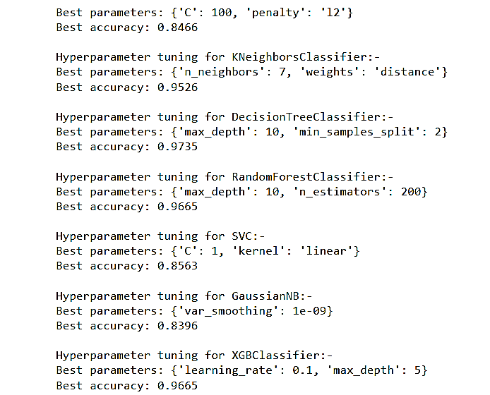
After hyper parameter tuning we get :

Slide 30
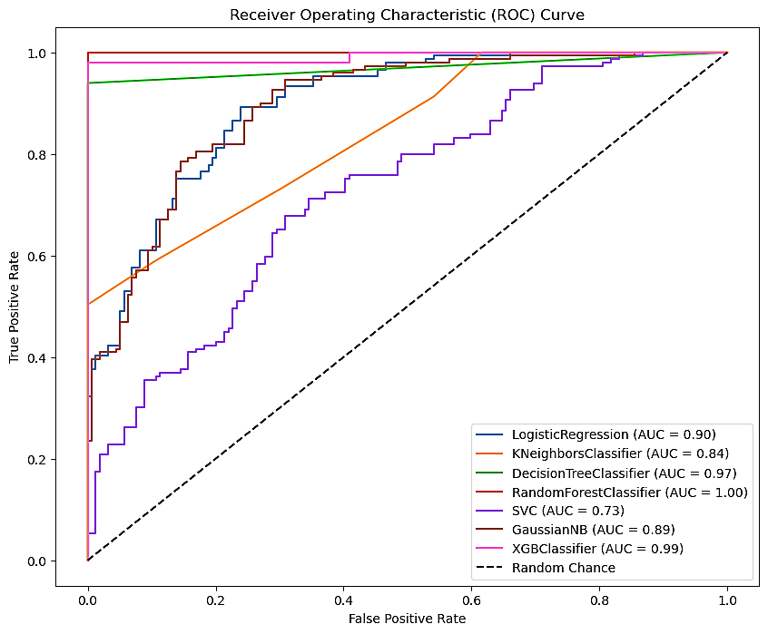

Slide 31
Conclusion
After conducting model training, testing, hyper parameter tuning, and analyzing the ROC curve, the Random Forest classifier emerged as the most suitable model.
The decision to proceed with it is based on its superior performance and ability to handle the given task effectively.
In summary, the recommendation to use the Random Forest classifier is grounded in a thorough analysis of its performance across various aspects of model development and evaluation.

Slide 32
Refrence:
https://www.kaggle.com/datasets/johnsmith88/heart-disease-dataset/
https://archive.ics.uci.edu/dataset/45/heart+disease

